Slide 1
Medicare Group Project

Slide 2
Eoghan Murray
Zac Dair
Aoise Warner
Daniel Murphy

Slide 3
Goals
Mobile application for individual users (Patients)
Website created for two different users (Doctors & Insurance providers)
Artificial Intelligence
Shared Database

Slide 4
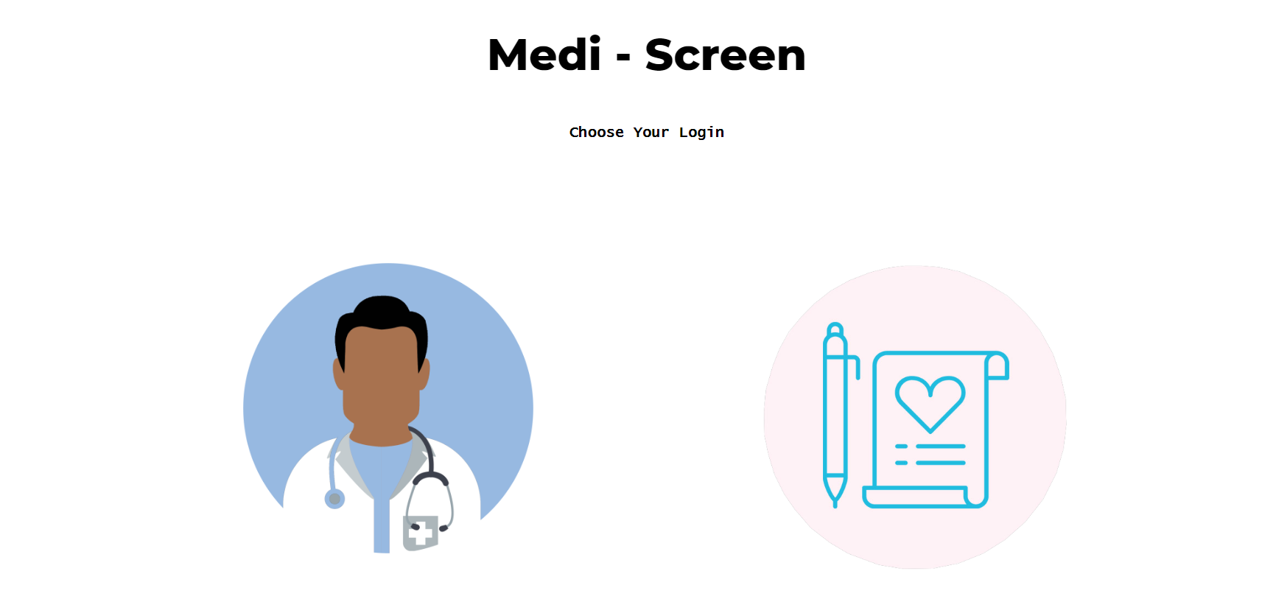
Website
Current design: HTML, PHP, CSS with some javascript.
Hosting: AWS Ubuntu lightsail server
Functioned for both Doctors and Insurance providers to either login or register.
Using SQL Database

Slide 5
Functionality of Website
Registration of Doctor/Insurance Provider
When logged in, the user will have access only to information relevant to them i.e. the Doctor will only see doctor related items while Insurance provider will only see insurance related items.
Both Doctor and Insurance professional will be able to view their own patients & generate a risk profile for their patients

Slide 6
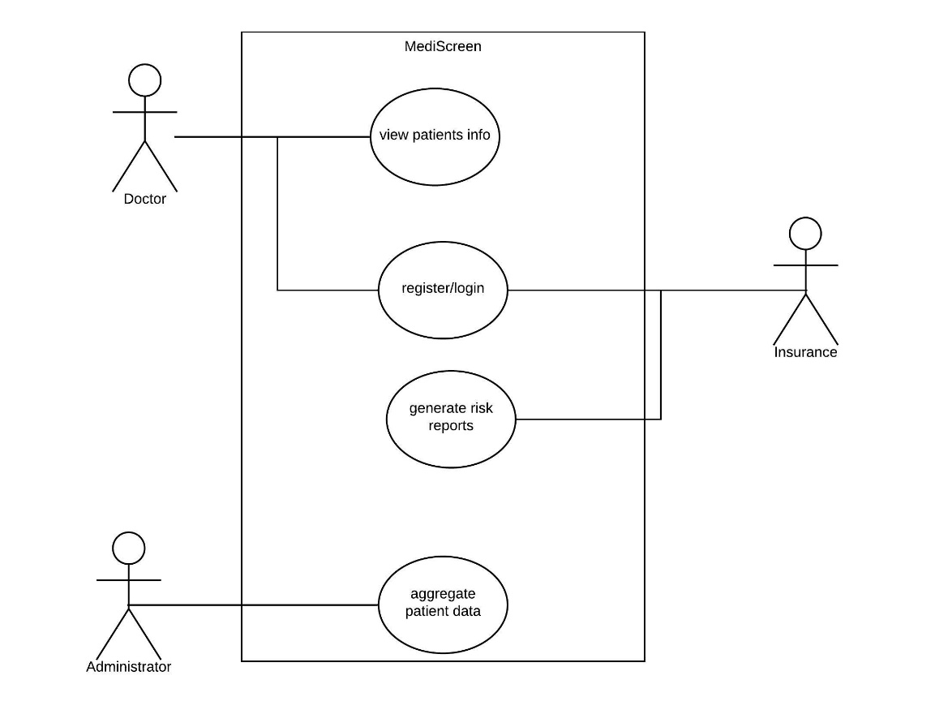
Website Use Case Diagram

Slide 7
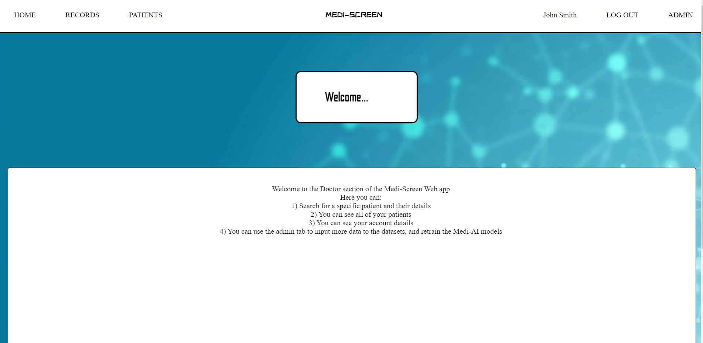
Home Page

Slide 8
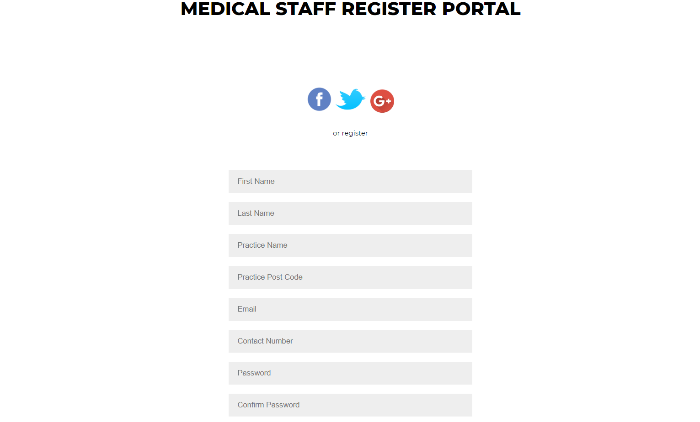
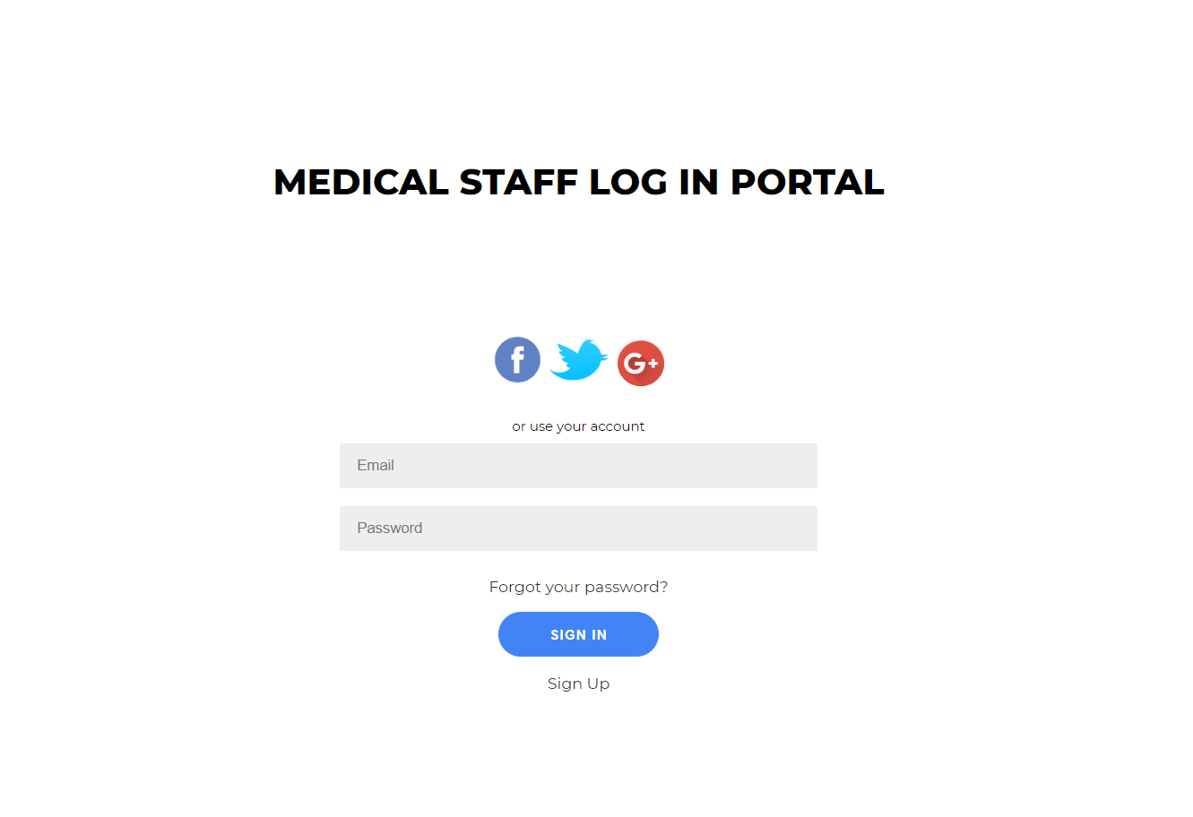
Login & Register

Slide 9
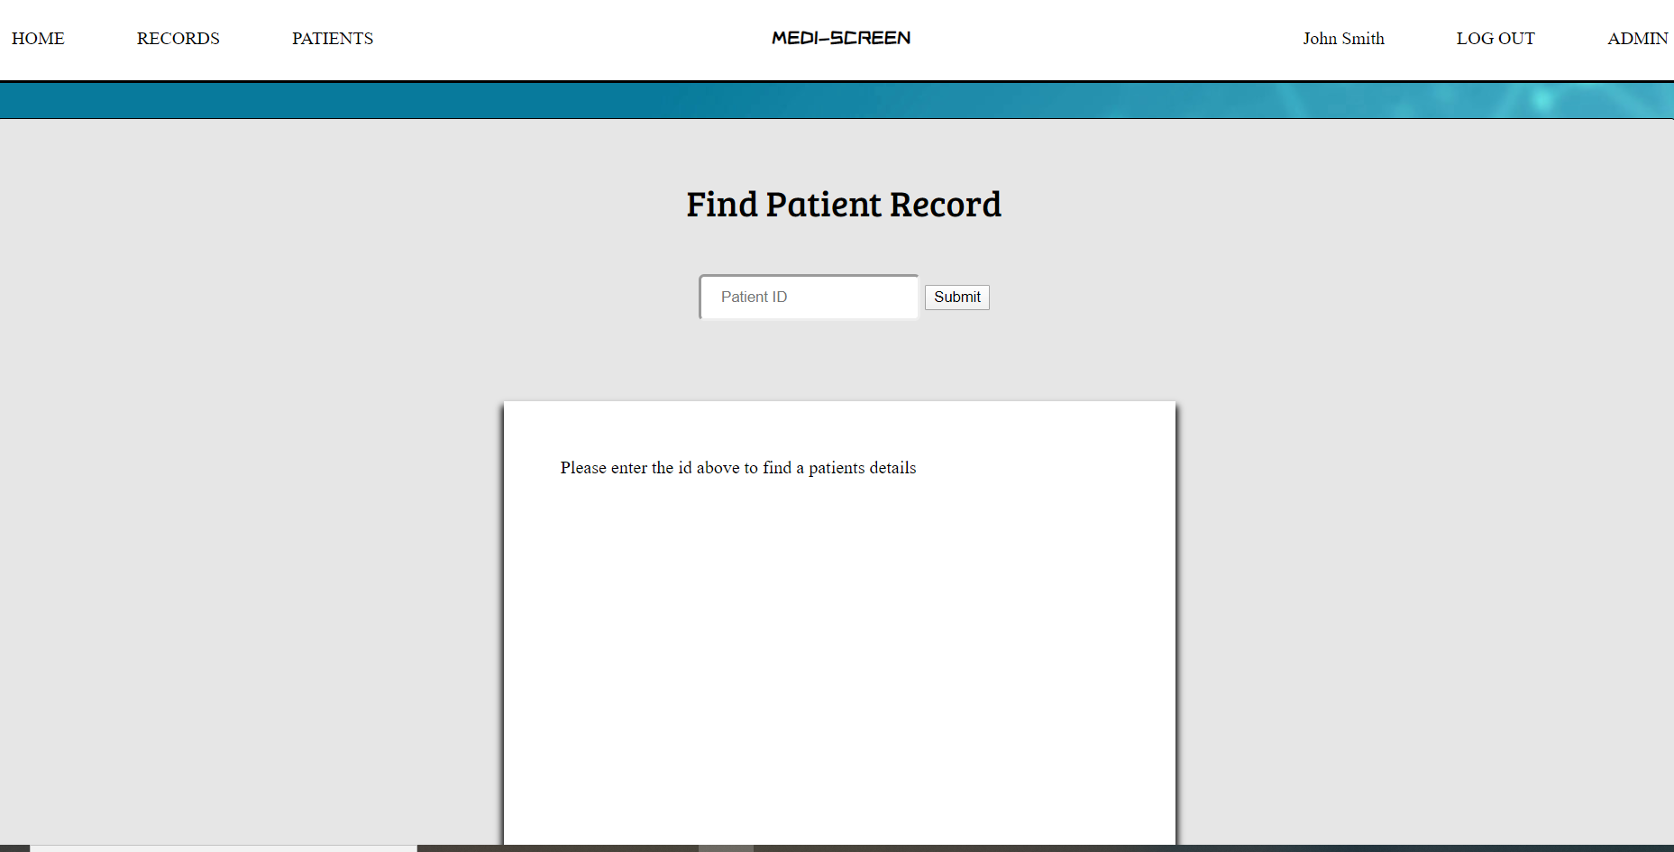
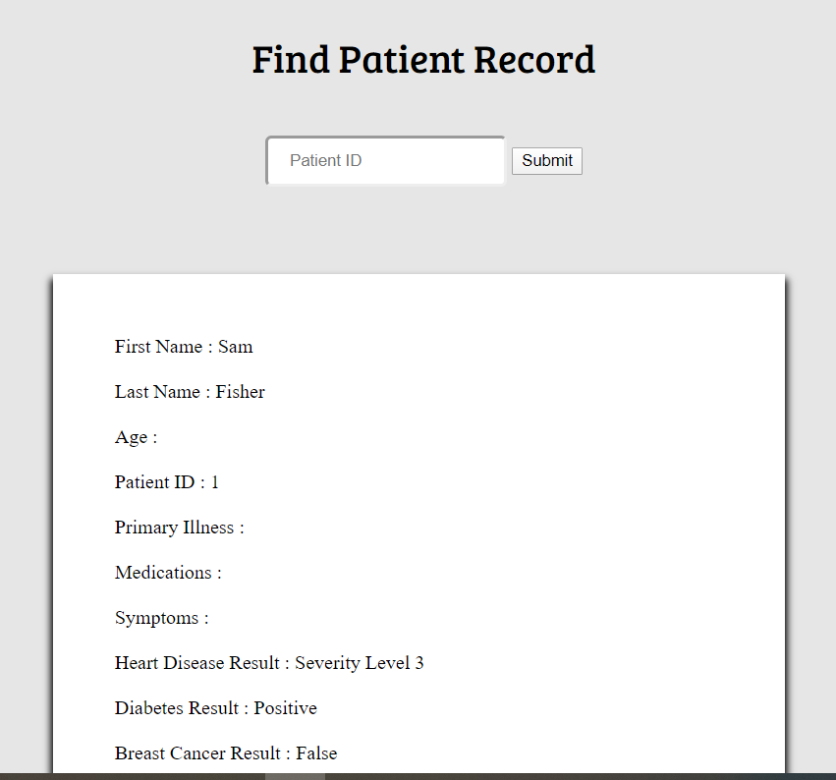
View Patients

Slide 10
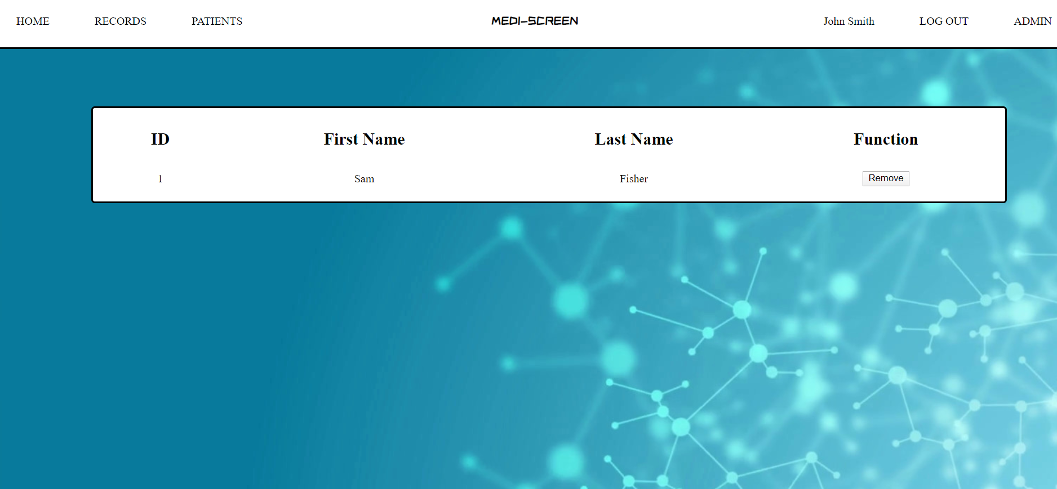
View all patients

Slide 11
Mobile Application
Development in: Android studio
Programmed using Java
Database: SQL

Slide 12
Login & Register

Slide 13
Medical history & AI interfacing

Slide 14
Request professional & support

Slide 15

Artificial intelligence
Using Keras for creation

Slide 16
Incomplete Tasks
Website
Mobile

Slide 17
Questions

Slide 18
Demonstration

